Slide 1
The battle of the neighborhoods
Finding the best renting places
Paulo Fernandes

Slide 2
Introduction
Moving to a new city to find new opportunities is a common thing.
Usually we are stuck with the option to renting a place.
A lot of places to renting available, specially in developed cities.
Trying to reduce the amount of options using Foursquare API and geographic information

Slide 3
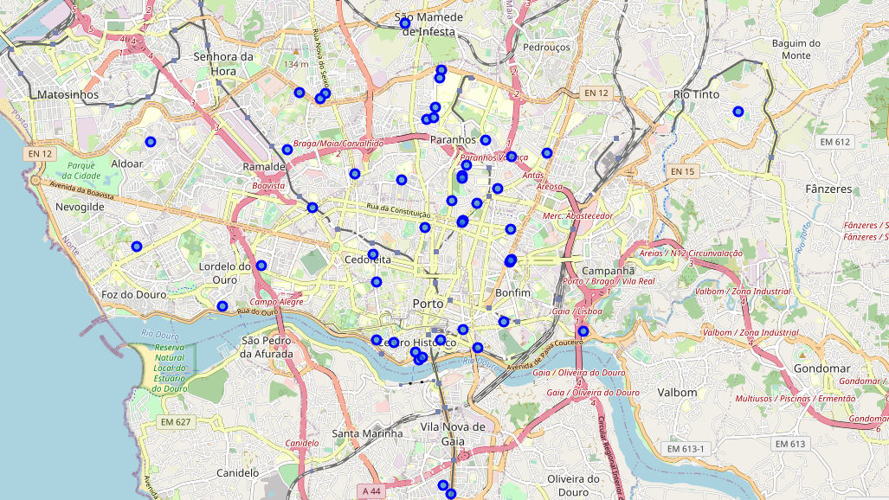
Built-in dataset:
50 places to rent in Porto, Portugal (using google location and a website for renting)

Slide 4
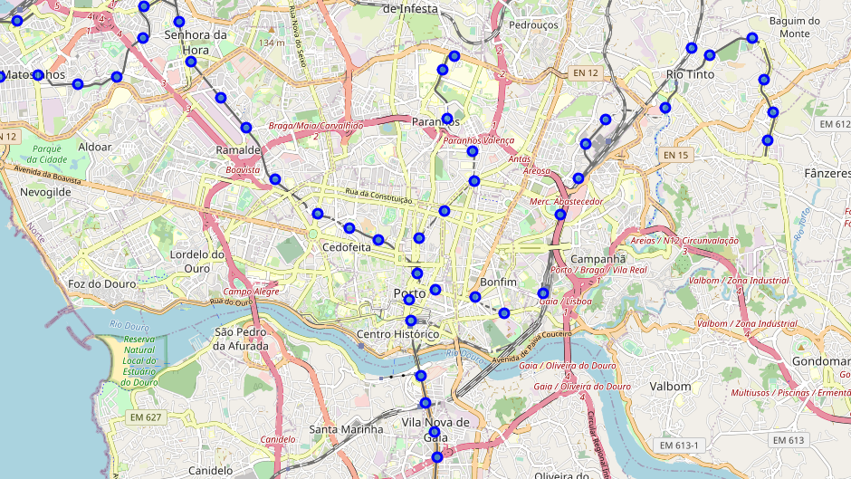
Built-in dataset:
Porto’s subway stations (using google location)

Slide 5
Conditions
Closer to at least 1 subway station (less than 1km)
Closer to at least 1 fitness club (less than 1km)
Furniture included
Total number of venues on a radius of 500m
Not being too expensive:
Less than 400€/month for rooms and 450€/month for studios and t1. (bills included)

Slide 6
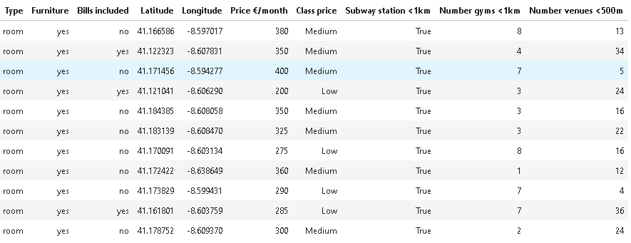
Final dataset of viable options

Slide 7
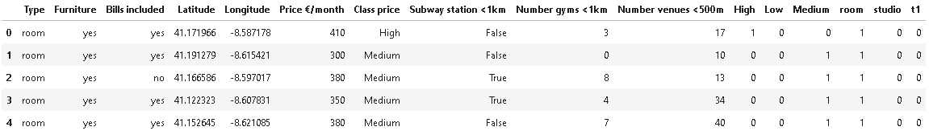
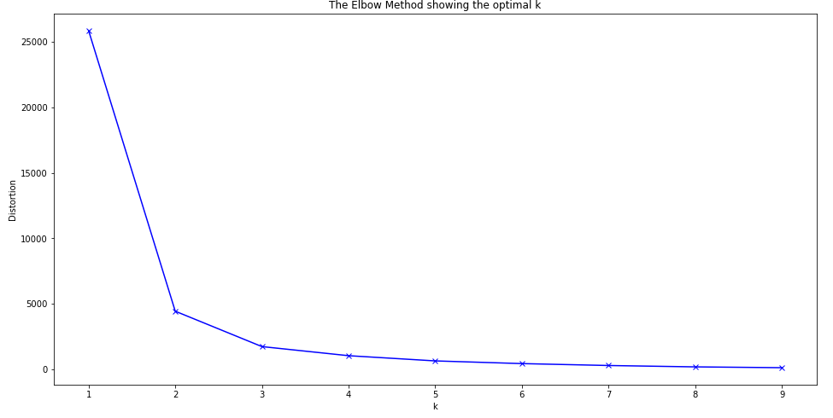
Impact of the number of venues on the pricing - kmeans
Prepare a dataset to apply the k-mean method
Removing not necessary variables(columns)
Getting dummies variables
Obtain the ideal number of clusters: 3

Slide 8
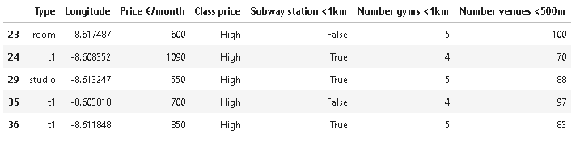
Results
A reduced amount of places to consider (1/5).
This places fulfill our conditions. If we want to reduce the amount of options we can add more conditions.
The number of closer venues influences the price of the renting. Using this information is a good way to decide is a place might be overpriced.

Slide 9
Conclusion
Overall the goal of the project was fulfill.
You don’t need complicated algorithms to solving a problem in Data Science. Cleaning and build a better dataset and then filtering the best options is an example of that.
Improves for the future:
A bigger dataset with more features
A more detailled analysis of the venues adn districts within the city; using more classification models

